Slide 1
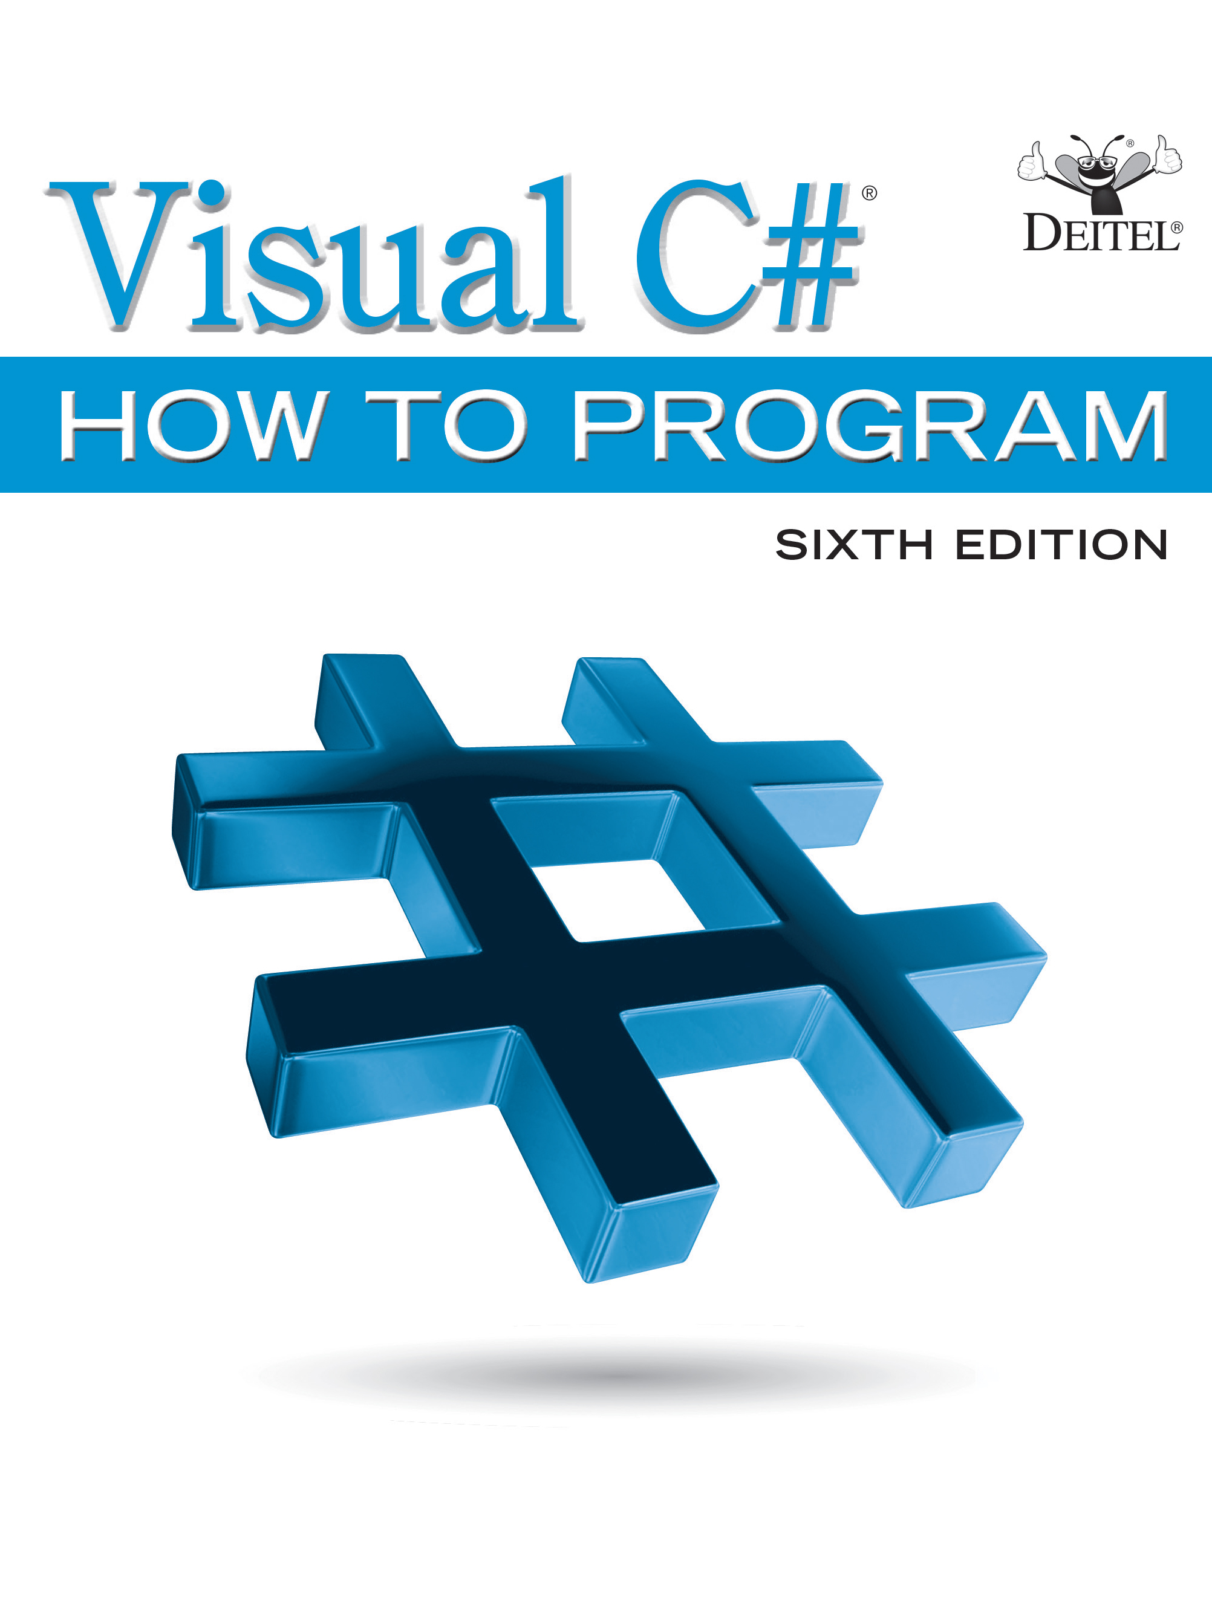
Visual C sharp® How to Program
Sixth Edition
Chapter 2
Introduction to Visual Studio and Visual Programming
Slides in this presentation contain hyperlinks. JAWS users should be able to get a list of links by using INSERT+F7
Copyright © 2017 Pearson Education, Inc. All Rights Reserved
Notes:
If this PowerPoint presentation contains mathematical equations, you may need to check that your computer has the following installed:
1) MathType Plugin
2) Math Player (free versions available)
3) NVDA Reader (free versions available)

Slide 2
Learning Objectives
Learn the basics of the Visual Studio Community 2015 Integrated Development Environment (I D E) for writing, running and debugging your apps.
Create a new project using Visual Studio’s Windows Forms Application template.
Be introduced to Windows Forms and the controls you’ll use to build graphical user interfaces.
Use key commands contained in the I D E’s menus and toolbars.
Understand the purpose of the various windows in the Visual Studio.
Use Visual Studio’s help features.
Use visual app development to conveniently create, compile and execute a simple Visual
app that displays text and an image.

Slide 3
Outline (1 of 2)
2.1 Introduction
2.2 Overview of the Visual Studio Community 2015 I D E
2.2.1 Introduction to Visual Studio Community 2015
2.2.2 Visual Studio Themes
2.2.3 Links on the Start Page
2.2.4 Creating a New Project
2.2.5 New Project Dialog and Project Templates
2.2.6 Forms and Controls
2.3 Menu Bar and Toolbar

Slide 4
Outline (2 of 2)
2.4 Navigating the Visual Studio I D E
2.4.1 Solution Explorer
2.4.2 Toolbox
2.4.3 Properties Window
2.5 Help Menu and Context-Sensitive Help
2.6 Visual Programming: Creating a Simple App that Displays Text and an Image
2.7 Wrap-Up
2.8 Web Resources

Slide 5
2.1 Introduction
Visual Studio is Microsoft’s Integrated Development Environment (I D E) for creating, running and debugging
apps (also called applications) written in
and various
other. NET programming languages.
In this chapter, we overview the Visual Studio Community 2015 I D E, then show how to create a simple Visual
app by dragging and dropping predefined building blocks into place—a technique known as visual app development.

Slide 6
2.2 Overview of the Visual Studio Community 2015 I D E
This book’s examples, screen captures and discussions are based on the free Visual Studio Community 2015 running on Windows 10.
The examples will work on full versions of Visual Studio as well—though some options, menus and instructions might differ.
From this point forward, we’ll refer to Visual Studio Community 2015 simply as “Visual Studio” or “the I D E.” We assume that you have some familiarity with Windows.

Slide 7
2.2.1 Introduction to Visual Studio Community 2015
When you open Visual Studio it initially displays the Start Page (Figure 2.1).
Depending on your version of Visual Studio, your Start Page may look different.
The Start Page contains a list of links to Visual Studio resources and web-based resources.
At any time, you can return to the Start Page by selecting View → Start Page.

Slide 8
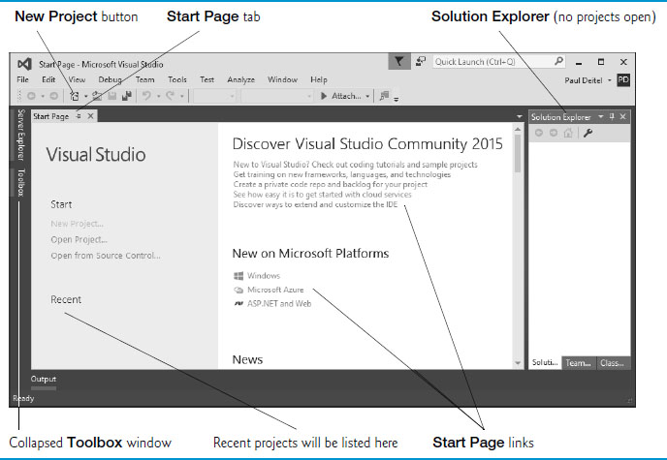
Figure 2.1 Start Page in Visual Studio Community 2015

Slide 9
2.2.2 Visual Studio Themes
Visual Studio supports three themes that specify the I D E’s color scheme:
a dark theme (with dark window backgrounds and light text)
a light theme (with light window backgrounds and dark text) and
a blue theme (with light window backgrounds and dark text).
We use the blue theme throughout this book.
The Before You Begin section after the Preface explains how to set this option.

Slide 10
2.2.3 Links on the Start Page (1 of 2)
The Start Page links are organized into two columns.
The left column’s Start section contains options for building new apps or working on existing ones.
The left column’s Recent section contains links to projects you’ve recently created or modified.

Slide 11
2.2.3 Links on the Start Page (2 of 2)
The Start Page’s right column contains links to various online documentation and resources to help you get started with Visual Studio and learn about Microsoft programming technologies.
To access more extensive information on Visual Studio, you can browse the M S D N (Microsoft Developer Network) Library at
https://msdn.microsoft.com/library/dd831853
You also can browse the web from the I D E by selecting View → Other Windows → Web Browser.
To request a web page, type its U R L into the location bar (Figure 2.2) and press Enter

Slide 12
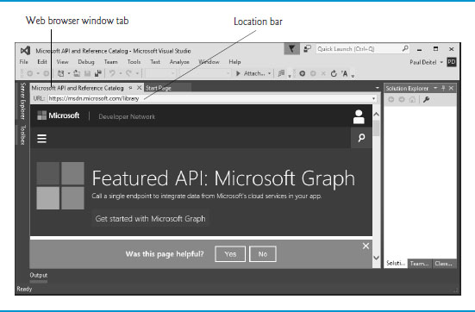
Figure 2.2 M S D N Library Web Page in Visual Studio

Slide 13
2.2.4 Creating a New Project
A project is a group of related files, such as the Visual
code and any images that might make up an app.
Visual Studio organizes apps into projects and solutions, which contain one or more projects.
Multiple-project solutions are used to create large-scale apps.
You select File → New → Project… to create a new project or File → Open → Project/Solution… to open an existing one.
You also can click the corresponding links in the Start Page’s Start section.

Slide 14
2.2.5 New Project Dialog and Project Templates (1 of 2)
For the discussions in the next several sections, we’ll create a new project. Select File → New → Project… to display the New Project dialog (Figure 2.3).
Dialogs are windows that facilitate user–computer communication.

Slide 15
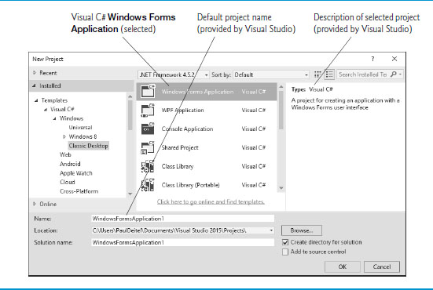
Figure 2.3 New Project Dialog

Slide 16
2.2.5 New Project Dialog and Project Templates (2 of 2)
Visual Studio provides many templates—the project types
that users can create in Visual
and other languages.
A Windows Forms Application is an app that executes within a Windows operating system and typically has a graphical user interface (G U I).
Users interact with this visual part of the app.
To create a Windows Forms Application, under Templates
select Visual
→ Windows → Classic Desktop, then in the middle column select Windows Forms Application.
Click OK to display the I D E in Design view (Figure 2.4), which contains the features that enable you to create an app’s G U I.

Slide 17
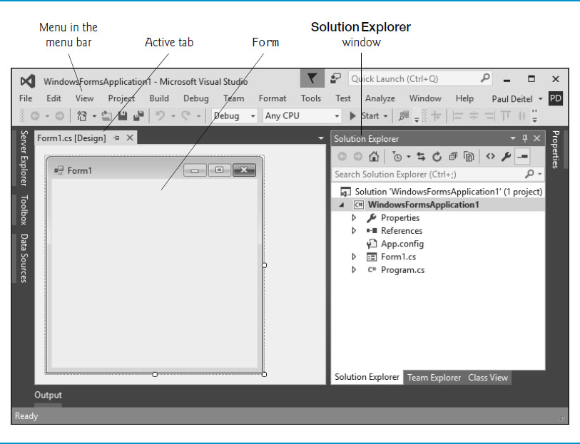
Figure 2.4 Design View of the I D E

Slide 18
2.2.6 Forms and Controls (1 of 2)
The rectangle in the Design area titled Form1 (called a Form) represents the main window of the Windows Forms app.
Each Form is an object of class Form in the .NET Framework Class Library.
Apps can have multiple Forms (windows).
A Label typically contains descriptive text (for example,
“Welcome to Visual
!”), and a PictureBox displays an
image.
Visual Studio has many preexisting controls and other components you can use to build and customize your apps.
Collectively, the Form and controls make up the app’s G U I.

Slide 19
2.2.6 Forms and Controls (2 of 2)
Each open document’s name is listed on a tab. To view a document when multiple documents are open, click its tab.
The active tab (the tab of the currently displayed document) is highlighted.
The active tab’s highlight color depends on the Visual Studio theme—the blue theme uses a yellow highlight and the light and dark themes use a blue highlight.

Slide 20
2.3 Menu Bar and Toolbar (1 of 3)
Commands for managing the I D E and for developing, maintaining and executing apps are contained in menus, which are located on the menu bar of the I D E (Figure 2.5).
The set of menus displayed depends on what you’re currently doing in the I D E.
Menus contain groups of related commands called menu items that, when selected, cause the I D E to perform specific actions.
The menus depicted in Figure 2.5 are summarized in Figure 2.6.

Slide 21
Figure 2.5 Visual Studio Menu Bar

Slide 22
Figure 2.6 Summary of Visual Studio Menus That Are Displayed When a Form is in Design View (1 of 2)
Menu | Contains commands for
File | Opening, closing, adding and saving projects, as well as printing project data and exiting Visual Studio.
Edit | Editing apps, such as cut, copy, paste, undo, redo, delete, find and select.
View | Displaying I D E windows (for example, Solution Explorer, Toolbox, Properties window) and for adding toolbars to the I D E.
Project | Managing projects and their files.
Build | Turning your app into an executable program.
Debug | Compiling, debugging (that is, identifying and correcting problems in apps) and running apps.
Team | Connecting to a Team Foundation Server—used by development teams that typically have multiple people working on the same app.

Slide 23
Figure 2.6 Summary of Visual Studio Menus That Are Displayed When a Form is in Design View (2 of 2)
Menu | Contains commands for
Format | Arranging and modifying a Form’s controls. The Format menu appears only when a G U I component is selected in Design view.
Tools | Accessing additional I D E tools and options for customizing the I D E.
Test | Performing various types of automated testing on your app.
Analyze | Locating and reporting violations of the NET Framework Design Guidelines (https://msdn.microsoft.com/library/ms229042).
Window | Hiding, opening, closing and displaying I D E windows.
Help | Accessing the I D E’s help features.

Slide 24
2.3 Menu Bar and Toolbar (2 of 3)
You can access many common menu commands from the toolbar (Figure 2.7), which contains icons that graphically represent commands.
By default, the standard toolbar is displayed when you run Visual Studio for the first time—it contains icons for the most commonly used commands, such as opening a file, saving files and running apps.
The icons that appear on the standard toolbar may vary, depending on the version of Visual Studio you’re using.

Slide 25
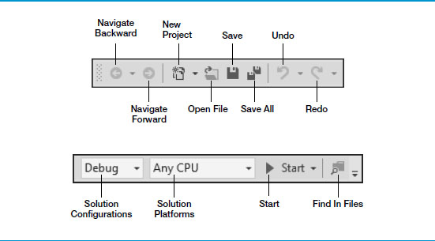
Figure 2.7 Standard Visual Studio Toolbar

Slide 26
2.3 Menu Bar and Toolbar (3 of 3)
You can customize which toolbars are displayed by selecting View → Toolbars then selecting a toolbar from the list in Figure 2.8.
Each toolbar you select is displayed with the other toolbars at the top of the Visual Studio window.
You move a toolbar by dragging its handle
To execute a command via the toolbar, click its icon.
Hovering the mouse pointer over an icon highlights it and displays a description of the icon called a tool tip (Figure 2.9)

Slide 27
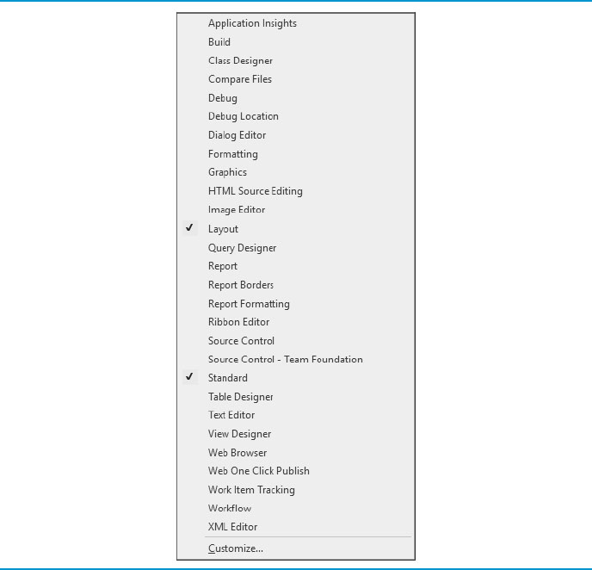
Figure 2.8 List of Toolbars That Can Be Added to the Top of the I D E

Slide 28
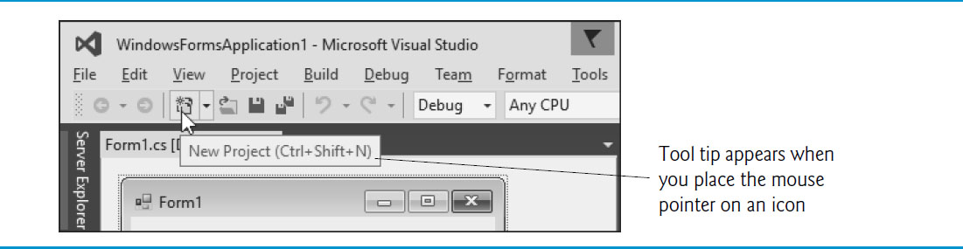
Figure 2.9 Tool Tip for the New Project Button

Slide 29
2.4 Navigating the Visual Studio I D E
The I D E provides windows for accessing project files and customizing controls. Each can be accessed by selecting its name in the View menu.
Visual Studio provides an auto-hide space-saving feature.
When auto-hide is enabled for a window, a tab containing the window’s name appears along the I D E window’s left, right or bottom edge (Figure 2.10).
Clicking the name of an auto-hidden window displays that window (Figure 2.11).
Clicking the name again (or clicking outside) hides the window.
To “pin down” a window (that is, to disable auto-hide and keep the window open), click the pin icon.
When auto-hide is enabled, the pin icon is horizontal
When a window is “pinned down,” the pin icon is vertical

Slide 30
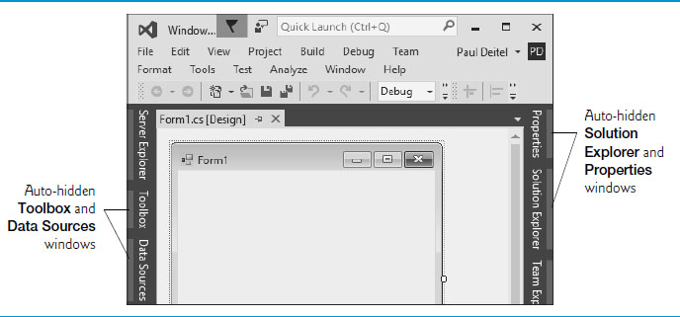
Figure 2.10 Auto-Hide Feature Emonstration

Slide 31
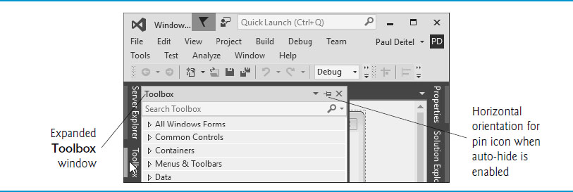
Figure 2.11 Displaying the Hidden Toolbox Window When Auto-Hide Is Enabled

Slide 32
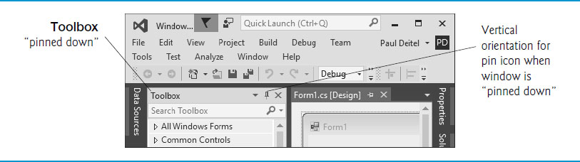
Figure 2.12 Disabling Auto-Hide— “Pinning down” a Window

Slide 33
2.4.1 Solution Explorer (1 of 3)
The Solution Explorer window (Figure 2.13) provides access to all of a solution’s files.
If it’s not shown in the I D E, select View → Solution Explorer.
When you open a new or existing solution, the Solution Explorer displays the solution’s contents.

Slide 34
2.4.1 Solution Explorer (2 of 3)
The solution’s startup project (shown in bold in the Solution Explorer) is the one that runs when you select Debug → Start Debugging (or press F5) or select Debug → Start Without Debugging (or press Ctrl + F5 key).
For a single-project solution, the startup project is the only project.
When you create an app for the first time, the Solution Explorer window appears as shown in Figure 2.13.
The Visual
file that corresponds to the Form shown
is named Form1.cs (selected in Figure 2.13).
Visual
files use the .cs file-name extension, which is short

Slide 35
2.4.1 Solution Explorer (3 of 3)
By default, the I D E displays only files that you may need to edit—other files that the I D E generates are hidden.
The Solution Explorer window includes a toolbar that contains several icons.
Clicking the Show All Files icon (Figure 2.13) displays all the solution’s files, including those generated by the I D E.
Clicking the arrow to the left of a node expands or collapses that node.
Click the arrow to the left of References to display items grouped under that heading (Figure 2.14).
Click the arrow again to collapse the tree.

Slide 36
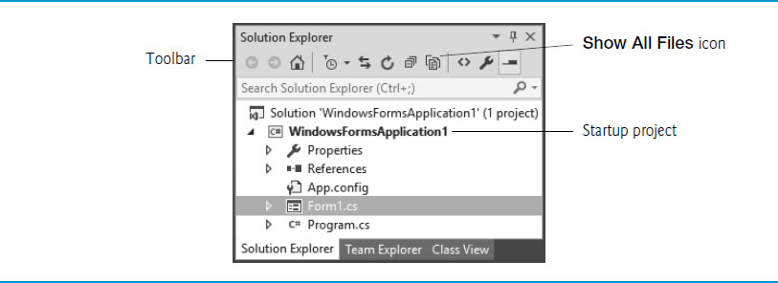
Figure 2.13 Solution Explorer Window Showing the WindowsFormsApplication1 Project

Slide 37
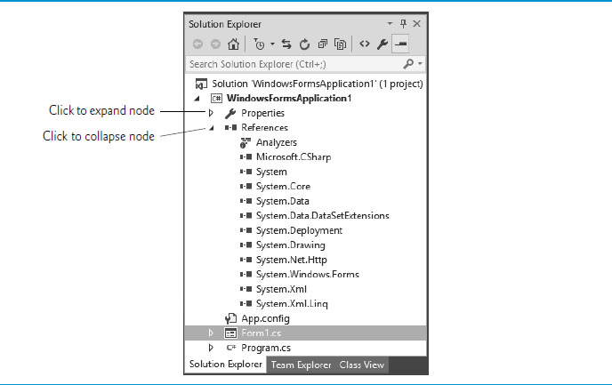
Figure 2.14 Solution Explorer with the References Node Expanded

Slide 38
2.4.2 Toolbox
To display the Toolbox window, select View → Toolbox.
Contains the controls used to customize Forms (Figure 2.15).
With visual app development, you can “drag and drop” controls onto the Form and the I D E will write the code that creates the controls for you.
The Toolbox groups the prebuilt controls into categories—All Windows Forms, Common Controls, Containers, Menus & Toolbars, Data, Components, Printing, Dialogs, Reporting, W P F Interoperability and General.

Slide 39
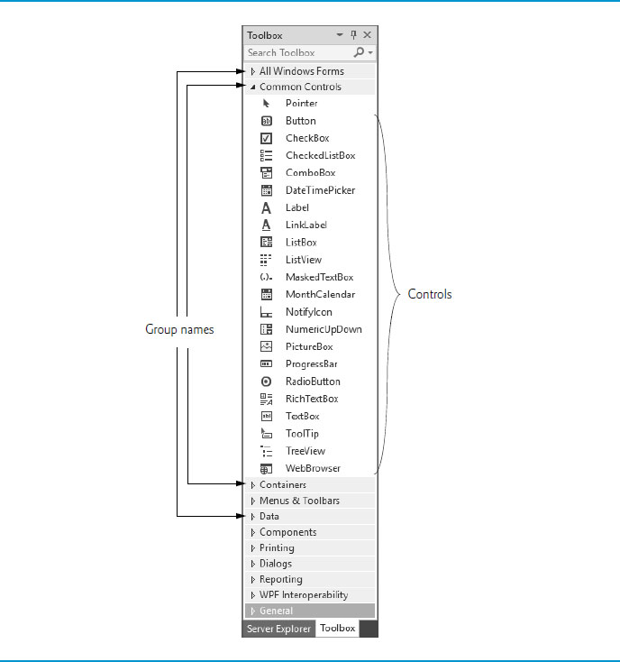
Figure 2.15 Toolbox Window Displaying Controls for the Common Controls Group

Slide 40
2.4.3 Properties Window (1 of 2)
If the Properties window is not displayed below the Solution Explorer, select View → Properties Window to display it.
The Properties window contains the properties for the currently selected Form, control or file in the I D E.
Properties specify information about the Form or control.
When you select a property, its description is displayed at the bottom of the Properties window.

Slide 41
2.4.3 Properties Window (2 of 2)
Figure 2.16 shows Form1’s Properties window—you can view by clicking anywhere in the Form1.cs [Design] window.
The left column lists the Form’s properties
The right column displays the current value of each property.
You can sort the properties either
alphabetically (by clicking the Alphabetical icon) or
categorically (by clicking the Categorized icon).
The Properties window is crucial to visual app development.

Slide 42
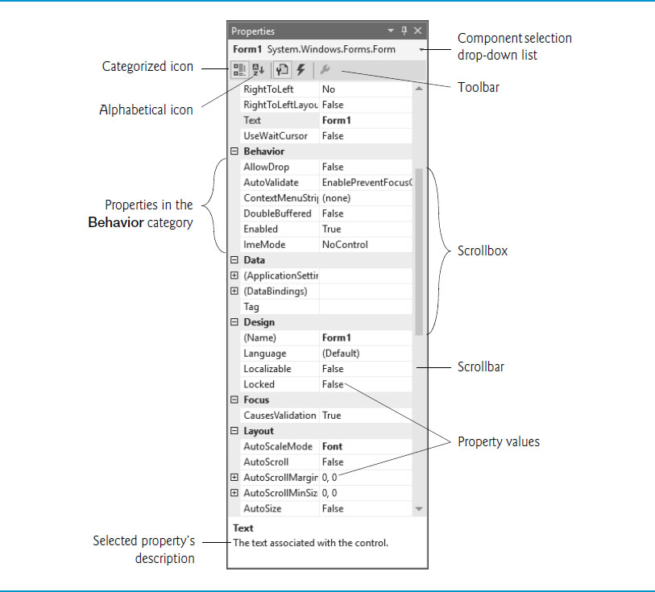
Figure 2.16 Properties Window

Slide 43
2.5 Help Menu and Context-Sensitive Help
Microsoft provides extensive help documentation via the Help menu, which is an excellent way to get information
quickly about Visual Studio, Visual
and more.
Visual Studio provides context-sensitive help pertaining to the “current content” (that is, the items around the location of the mouse cursor).
To use context-sensitive help, click an item, then press the F1 key.

Slide 44
2.6 Visual Programming: Creating a Simple App that Displays Text and an Image (1 of 12)
Next, we create an app that displays the text "Welcome to
Programming!" and an image of the Deitel & Associates bug mascot.
The app consists of a Form that uses a Label and a PictureBox. shows the final app executing.
The app and the bug image are available with this chapter’s examples.

Slide 45
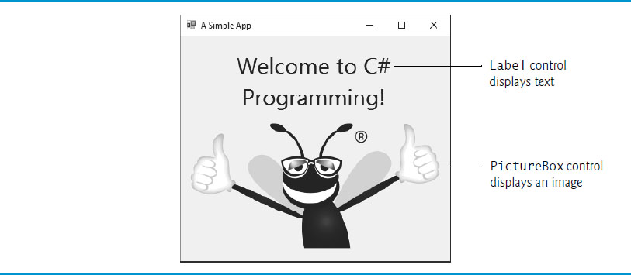
Figure 2.17 Simple App Executing

Slide 46
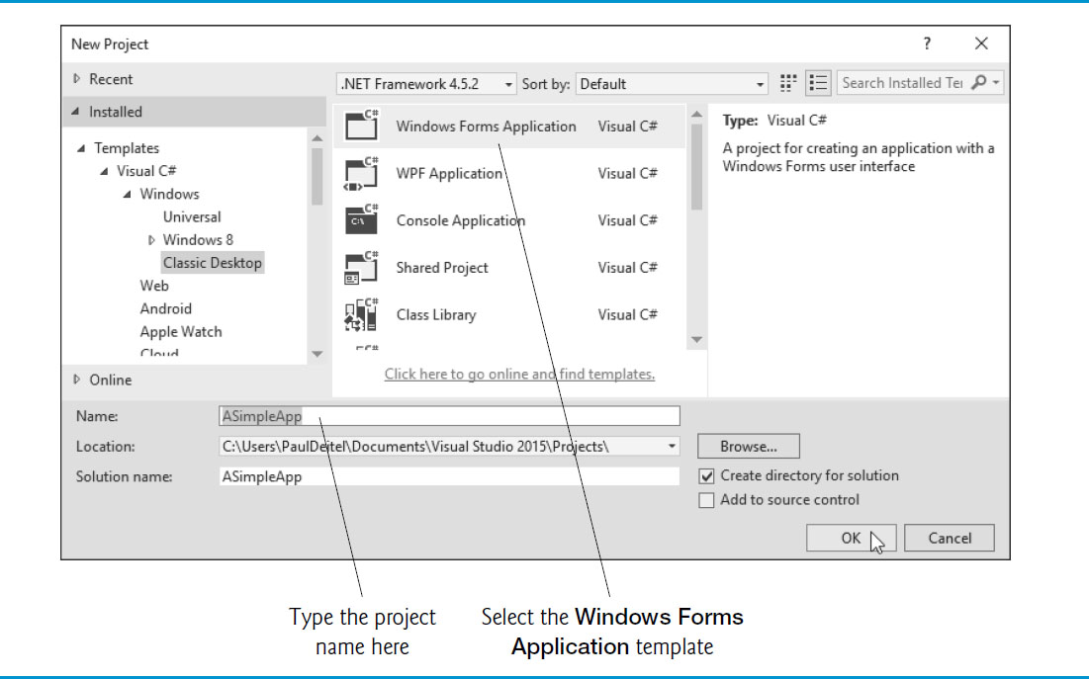
Figure 2.18 New Project Dialog

Slide 47
2.6 Visual Programming: Creating a Simple App that Displays Text and an Image (2 of 12)
The text in the Form’s title bar is determined by the Form’s Text property.

Slide 48
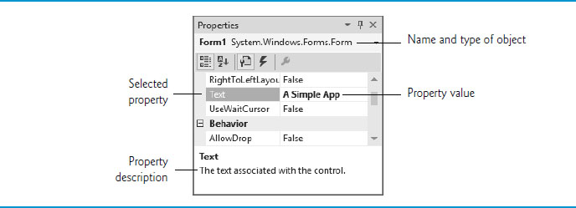
Figure 2.19 Setting the Form’s Text Property in the Properties Window

Slide 49
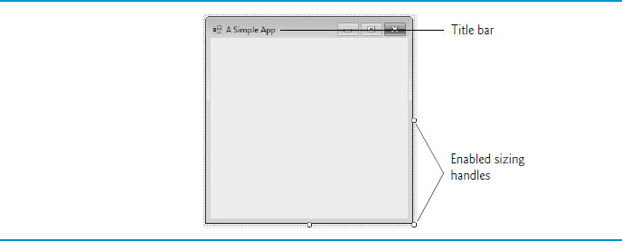
Figure 2.20 Form with Updated Title-Bar Text and Enabled Sizing Handles

Slide 50
2.6 Visual Programming: Creating a Simple App that Displays Text and an Image (3 of 12)
The Form’s size is specified in pixels (that is, dots on the screen).
By default, a Form is 300 pixels wide and 300 pixels tall.
You can resize the Form by dragging one of its sizing handles (the small white squares that appear around the Form, as shown in ).
As you drag the mouse, the I D E’s status bar (at the bottom of the I D E) shows the current width and height in pixels.
You also can do this via the Form’s Size property in the Properties window.

Slide 51
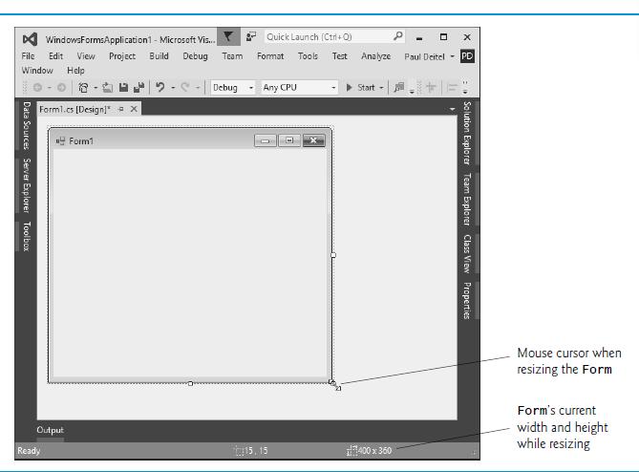
Figure 2.21 Resizing the Form

Slide 52
2.6 Visual Programming: Creating a Simple App that Displays Text and an Image (4 of 12)
The BackColor property specifies a Form’s or control’s background color.
Clicking BackColor in the Properties window causes a down-arrow button to appear next to the value of the property.
Clicking the down-arrow button displays other options, which vary depending on the property.

Slide 53
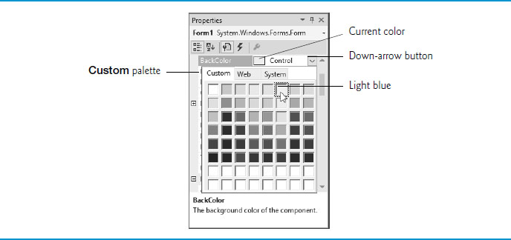
Figure 2.22 Changing the Form’s BackColor Property

Slide 54
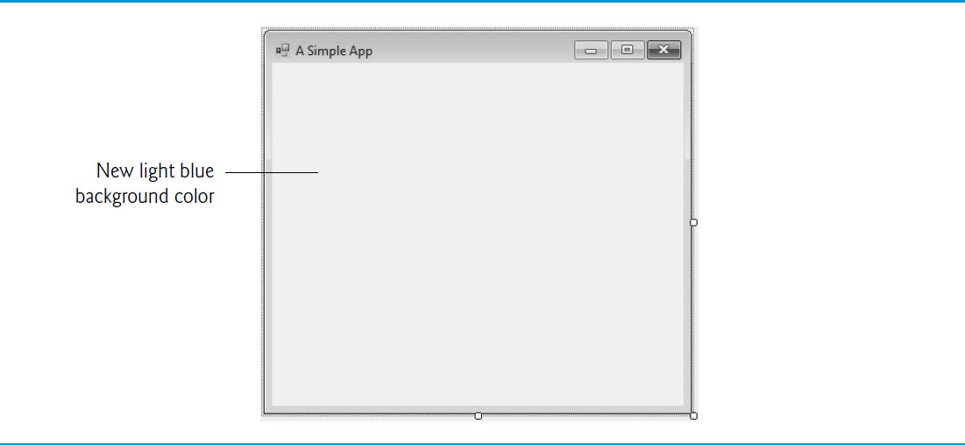
Figure 2.23 Form with New BackColor Property Applied

Slide 55
2.6 Visual Programming: Creating a Simple App that Displays Text and an Image (5 of 12)
Typical controls we use are located in the Toolbox’s Common Controls group, and also can be found in the All Windows Forms group.
Each Label you add to the Form is an object of class Label from the .N E T Framework Class Library.
By default, a Label’s BackColor is the same as the Form’s.

Slide 56

Figure 2.24 Adding a Label to the Form

Slide 57
2.6 Visual Programming: Creating a Simple App that Displays Text and an Image (6 of 12)
Form and Label each have their own Text property
By default, the AutoSize property of the Label is set to True so the Label can update its own size to fit all of its text.
Setting AutoSize property to False allows you to change the Label’s size using the sizing handles.
You can center a control horizontally by selecting Format → Center In Form → Horizontally.

Slide 58

Figure 2.25 G U I After the Form and Label Have Been Customized

Slide 59
2.6 Visual Programming: Creating a Simple App that Displays Text and an Image (7 of 12)
Step 8: Setting the Label’s Font Size
Select the value of a Label’s Font property, then click the ellipsis button to display the Font dialog (Figure 2.27).

Slide 60

Figure 2.26 Properties Window Displaying the Label’s Font Property

Slide 61
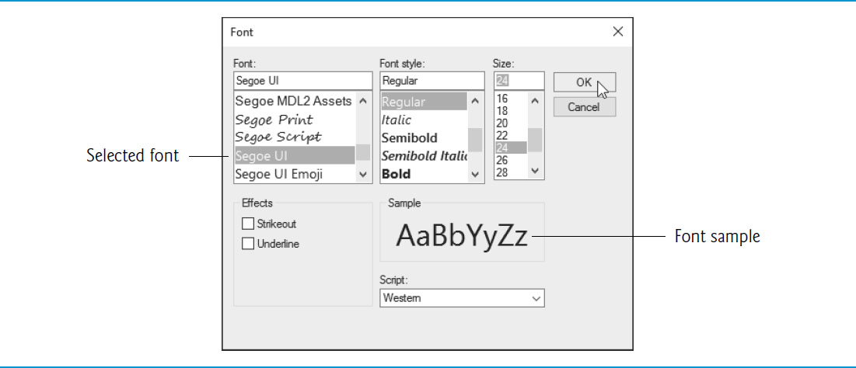
Figure 2.27 Font Dialog for Selecting Fonts, Styles and Sizes

Slide 62
2.6 Visual Programming: Creating a Simple App that Displays Text and an Image (8 of 12)
Select the Label’s TextAlign property to display a three-by-three grid of buttons representing alignment choices.
The position of each button corresponds to where the text appears in the Label.

Slide 63
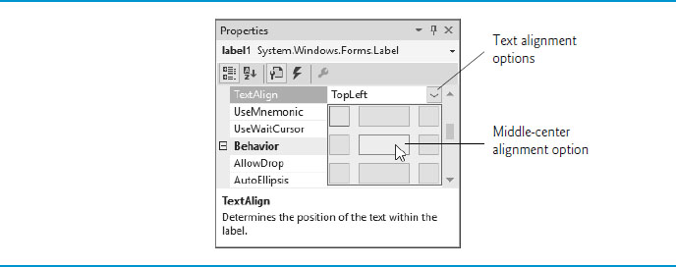
Figure 2.28 Centering the Label’s Text

Slide 64
2.6 Visual Programming: Creating a Simple App that Displays Text and an Image (9 of 12)
The PictureBox control displays images.
Each PictureBox you add to the Form is an object of class PictureBox from the .NET Framework Class Library.

Slide 65
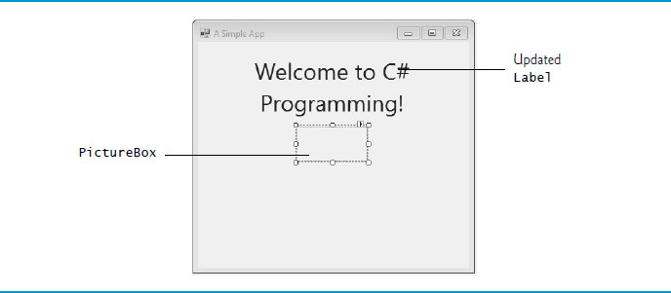
Figure 2.29 Inserting and Aligning a PictureBox

Slide 66
2.6 Visual Programming: Creating a Simple App that Displays Text and an Image (10 of 12)
The Image property specifies the image to display in a PictureBox.
To scale the image to fit in the PictureBox, change the SizeMode property to StretchImage.

Slide 67
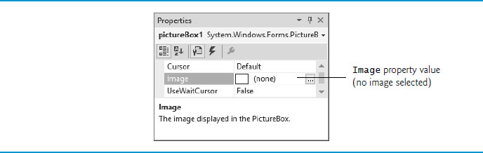
Figure 2.30 Image Property of the PictureBox

Slide 68
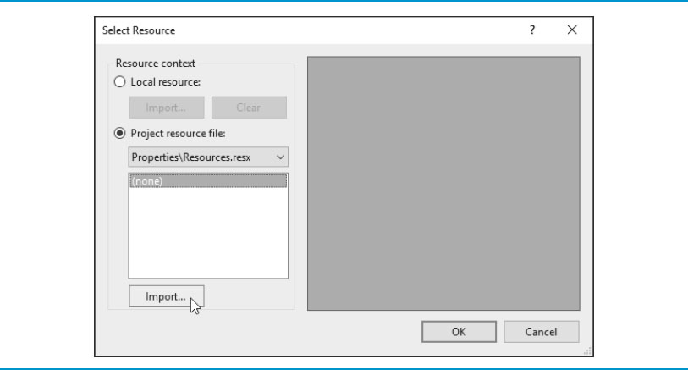
Figure 2.31 Select Resource Dialog to Select an Image for the PictureBox

Slide 69
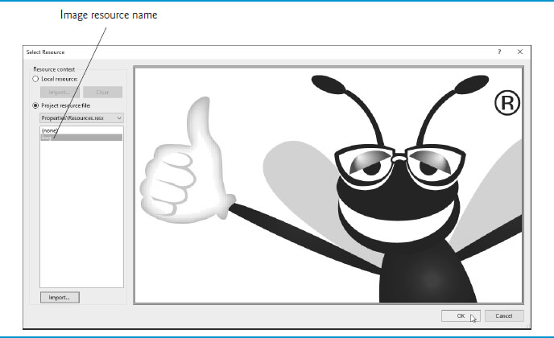
Figure 2.32 Select Resource Dialog Displaying a Preview of Selected Image

Slide 70
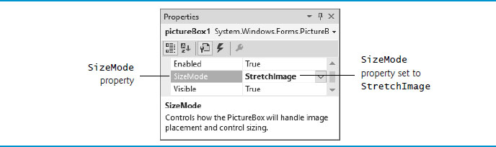
Figure 2.33 Scaling an Image to the Size of the PictureBox

Slide 71
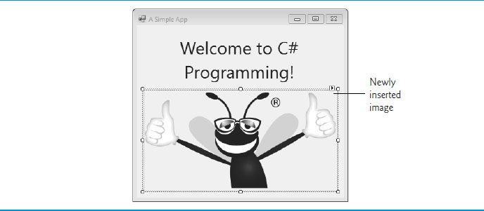
Figure 2.34 PictureBox Displaying an Image

Slide 72
2.6 Visual Programming: Creating a Simple App that Displays Text and an Image (11 of 12)
Select File → Save All to save the entire solution.
The solution file (which has the filename extension .sln) contains the name and location of its project, and the project file (which has the filename extension .csproj) contains the names and locations of all the files in the project.
If you want to reopen your project at a later time, simply open its .sln file.

Slide 73
2.6 Visual Programming: Creating a Simple App that Displays Text and an Image (12 of 12)
In run mode, the app is executing, and you can interact with only a few I D E features—features that are not available are disabled (grayed out).
Select Debug → Start Debugging to execute the app (or press the F5 key).
The I D E enters run mode and displays “(Running)” next to the app’s name in the I D E’s title bar.
Click the app’s close box (X) to terminate the app

Slide 74
Figure 2.35 I D E in Run Mode, with the Running App in the Foreground

Slide 75

Copyright

